Slide 1
Social Determinants: Social Isolation
ACAP CEO Summit June 29, 2018

Slide 2
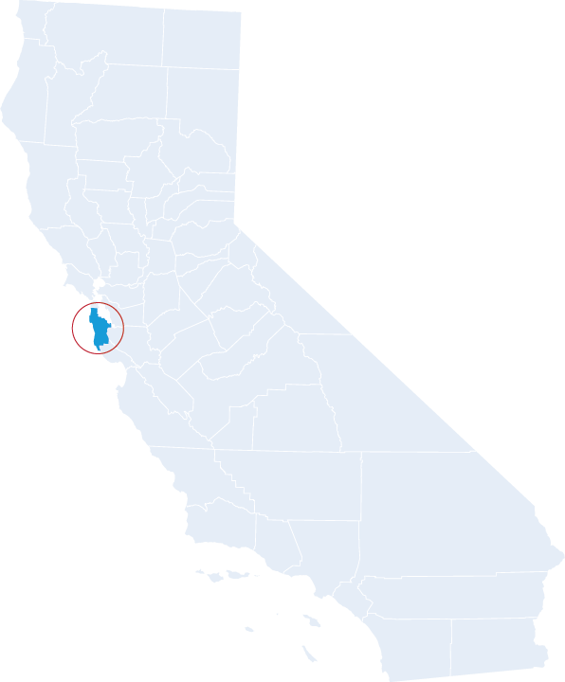
Health Plan of San Mateo 119,000 Medicaid 9,100 MMP

Slide 3
Strategic Initiatives
Housing Assistance
Home visits
Transportation
Social Isolation
Food Insecurity/ Nutrition

Slide 4
Connect for Life Program
Onboard
HPSM Pilot
50 members
3 groups
Medicare eligible older adults living in the community
Call center and mailers
Weekly small group facilitated meetings
Pain management
Chair Volleyball
Goal: make one friend
Movement
Health
promotion
Socialization
Wellness Ring
Wellness Ring

Slide 5
Lessons Learned
Positive impact on mental and physical health
Nudge desired member behaviors
Enrollment and retention
No limited to duals/ MMP or senior population
Personal interaction, mixed cohort

Slide 6
Positive Impact on Mental and Physical Health
N = 320
Health Outcomes
Projected Economics
Health outcomes Expenses
5 pts
MENTAL
COMPONENT
SCORE
31% improvement
+5 pts
$2635
+2 pts
$995
PHYSICAL COMPONENT SCORE
2 pts
12% improvement
On average the service saves $1815 PMPY in health spend.
MCS stands for Mental Component Score that assesses mental health
PCS stands for Physical Component Score which assesses physical health
Medical expense reduction assumes 8% utilization and average RAF of 1.0
* Source: Wider Circle
Notes:
MCS Over 12 months the raw score went up 4.46 points. If we equate 1 point different to 7% lower spend, then it's 31% lower spend of $2,635 per member (based on $8,500 cost per year). PCS
Over 12 months the raw score went up 1.95 points. If we equate 1 point different to 6% lower spend, then it's 12% lower spend of $995 per member (based on $8,500 cost per year).
Average
If we took the average of these improvements, it's $1,815 in savings a year

Slide 7
Lessons Learned
Positive impact on mental and physical health
Nudge desired member behaviors
Support enrollment and retention
Not limited to duals/ MMP or senior population
Personal interaction, mixed cohort

Slide 8
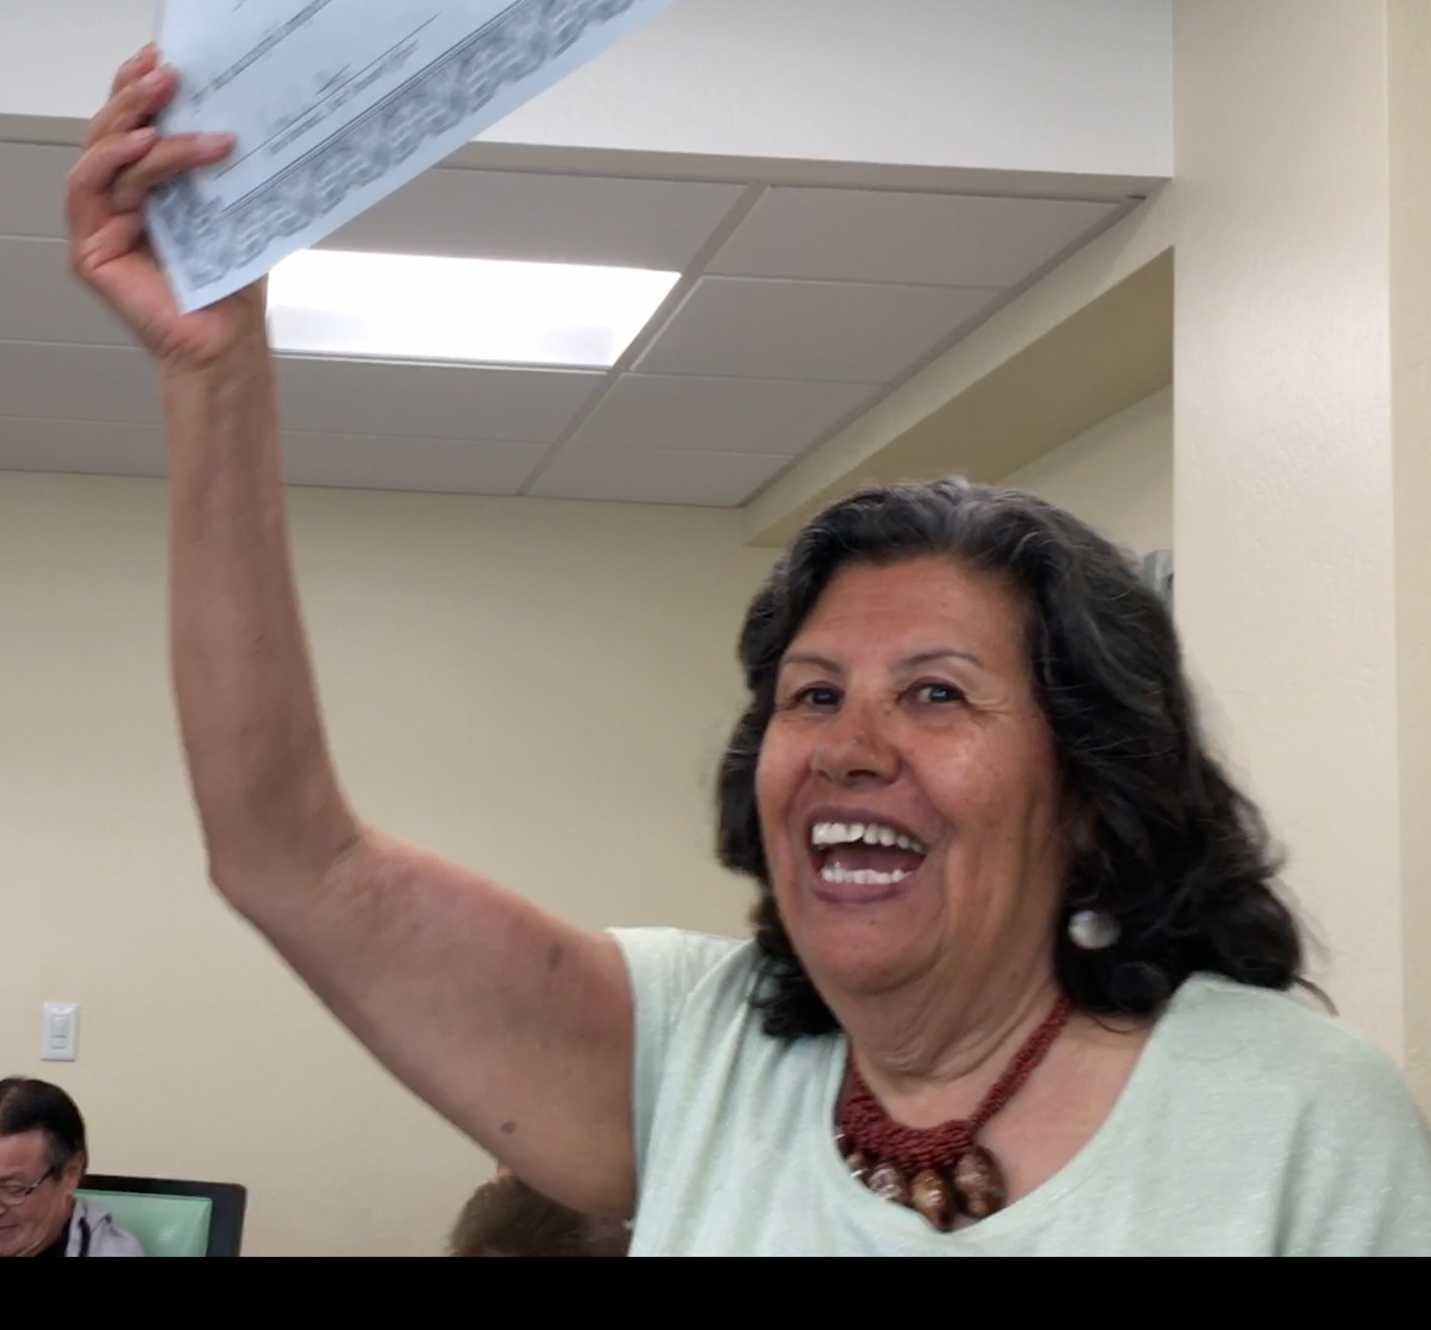
Video of Program Graduation

Slide 9
Lessons Learned
Positive impact on mental and physical health
Nudge desired member behaviors
Support enrollment and retention
Not limited to duals/ MMP or senior population
Personal interaction, mixed cohort

Slide 10
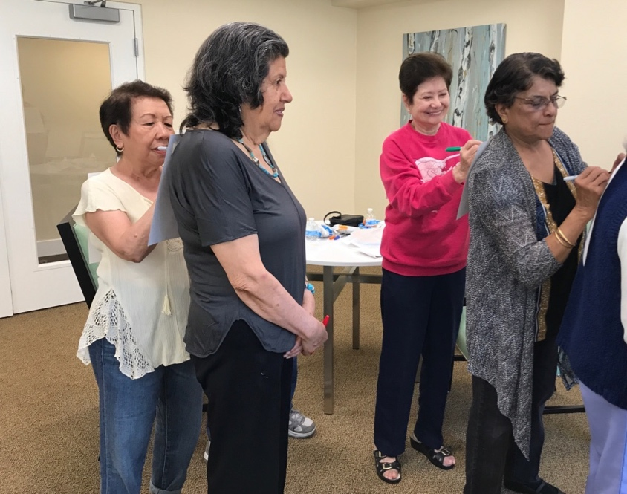
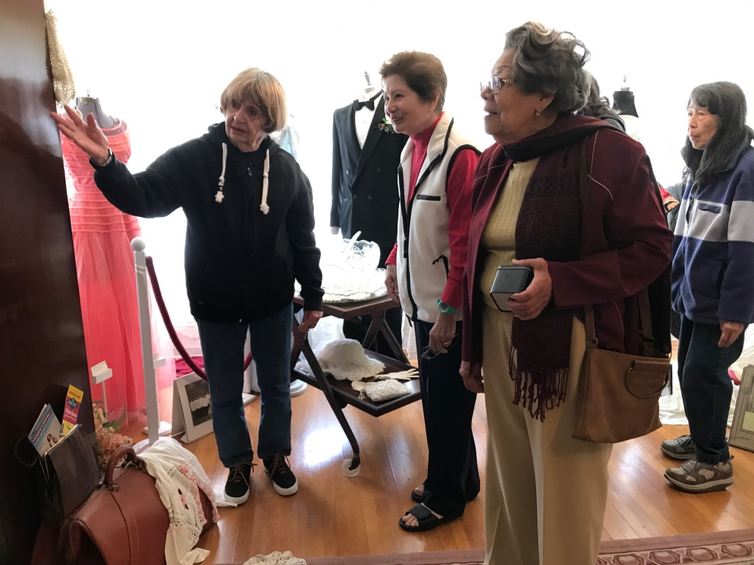
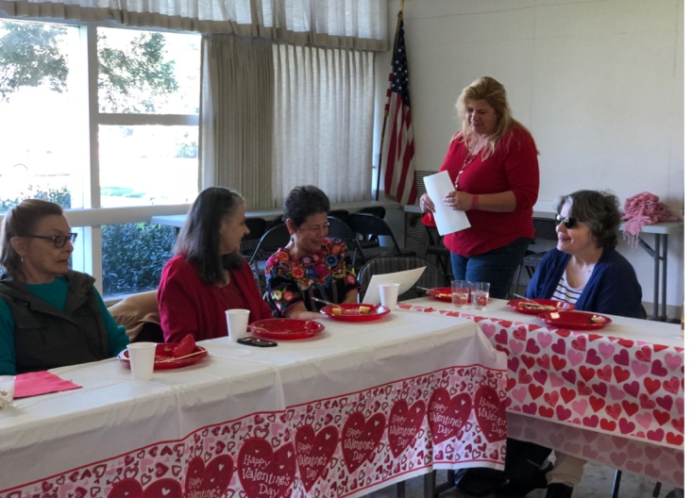
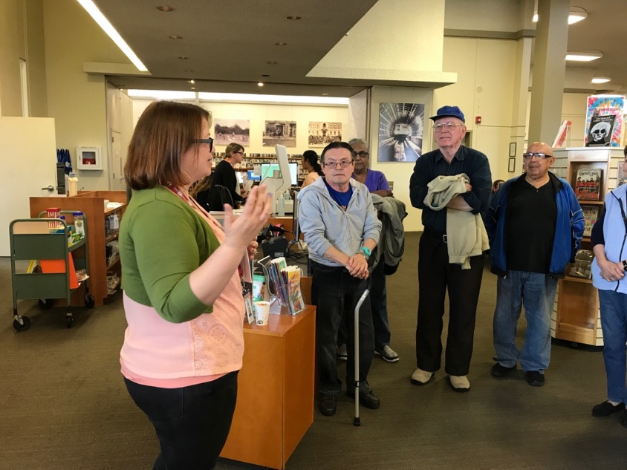
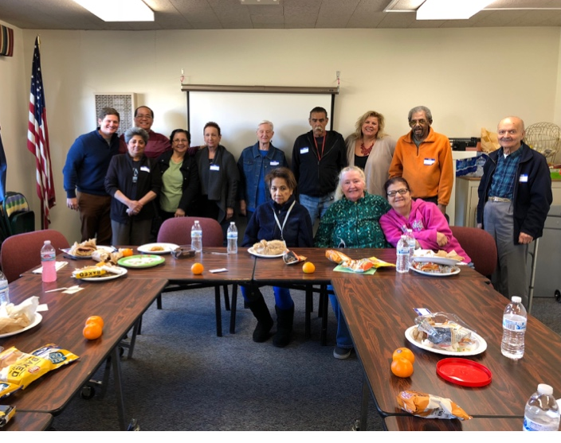
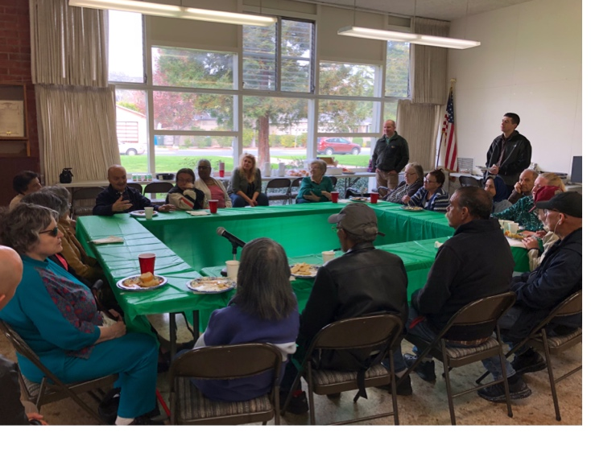
The People Behind the Pilot

Slide 11
Program Expansion
2018-2019
500 Members 50 Groups 50/50 MMP and non-MMP Additional Focus Enrollment HRA/ ICPs
2017-2018
50 Members 3 Groups

Slide 13
Thank You

