Slide 1
ACAP Dual Eligibles Toolkit: Summary Data for Indiana
Compiled by: Special Needs Consulting Services (SNCS)

Slide 2
Key Information, Indiana
Indiana has roughly 78,500 “full duals”
52% of these persons are age 65+
The full duals’ annual costs (across Medicaid and Medicare) now total approximately $300 billion – roughly $50,000 per person per year
65% of these expenditures are paid for by Medicaid
SNCS estimates that 3% of the Indiana duals’ costs are currently paid via capitation 97% via FFS
MCOs interested in serving duals under this demonstration need to engage in significant preparations during CY2012 (and CY2013)
Average lifetime revenue for each dual eligible enrolled is likely to approach or exceed $500,000, since most duals will remain eligible and enrolled for remainder of their lives (which should average > 10 years)
The high needs and high costs, coupled with the “rest of life” enrollment dynamic, creates profound and exciting care coordination opportunities
Moving Indiana’s duals into coordinated care also makes market positioning critically important for MCOs interested in serving this subgroup

Slide 3
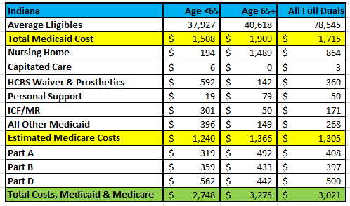
Estimated PMPM Cost, Indiana Full Duals, 2008

Slide 4
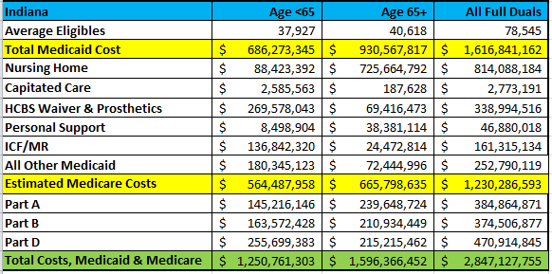
Estimated Total Dollar Cost, Indiana Full Duals, 2008

Slide 5
Publicly Available Resources Containing Data and/or Other Information About Indiana’s Dual Eligibles
Medicare-Medicaid Enrollee State Profile, Indiana, Centers for Medicare & Medicaid Services
http://www.integratedcareresourcecenter.com/PDFs/StateProfileIN.pdf
Indiana, Dual Eligibles: State Health Facts, Kaiser Family Foundation http://www.statehealthfacts.org/profileind.jsp?cat=6&sub=76&rgn=16
Achieving Optimal Care Coordination for Medicaid/Medicare Dual Eligibles, August 2011, Special Needs Consulting Services (Joel Menges, Jeremy Batt, Kaleigh Beronja, Jessica Wiecezak)
http://www.sncservices.com/Achieving%20Optimal%20Care%20Coordination%20for%20Dual%20Eligibles-%20FINAL.pdf

